Slide 1
Health Software for Bluetooth enabled Medical Devices
We have collaborated with XYZ company to provide health care software through blue tooth enabled technology.
SOFTWARE for Bluetooth enabled medical devices
Software helps to keep repository of health records of the patient.
This software can be used as a tool to detect diseases in early stage.
Plan to introduce this in the villages of Karnataka to track the health of the villagers.
Software can be customized for tracking other diseases like cancer, pregnancy tests etc.
We would be the contact point for Gram Panchayat for any support required for devices or software.
SENSOR based Fever Detector
We also wish to introduce sensor based fever detecting devise which can be deployed at the entrance of all large private and government buildings, banks, airports, railway stations, hospitals, shopping malls etc.
No manual intervention required.
Works like CCTV but detects the person having fever.
Plug & Play. No installation required.
https://www.youtube.cacto6o

Slide 2
Business Proposition
Problem Statement:
In a post COVID-19 world, the impact of epidemics and pandemics assumes prominence and has far reaching consequences into the social and economic fabrics of a nation.
Governments need to ensure sweeping changes to proactively monitor and pre-empt social scale medical adversities.
Solution
A population health analytics platform for the state of Himachal. A major tool for preventative diagnostics and a cornerstone for citizen healthcare initiatives by the Govt. of Himachal.
Connected devices and monitoring platform to be procured by state govt. and issued to relevant population subsets through state distribution networks including govt. health centers, schools and municipalities
Captures diagnostics from remote patients, avoids overpopulation at physical diagnostic centers and saves cost of travel.
Temperature monitoring and symptoms tracking will help prevent epidemics and save crores of rupees in health disaster management and associated economic fallouts.
Beneficial for health monitoring of Rajasthan’s remote rural population spread as well as densely populated town centers and compliant to Health Standards.
Real-time data availability to monitor epidemics, health and weather data visually.
Product
TEBP® Bluetooth “connected” thermometer linked to proprietary cloud-based telehealth tracking platform.
Scalable to include other “connected” diagnostic devices and customizable to customer specific requirements.

Slide 3
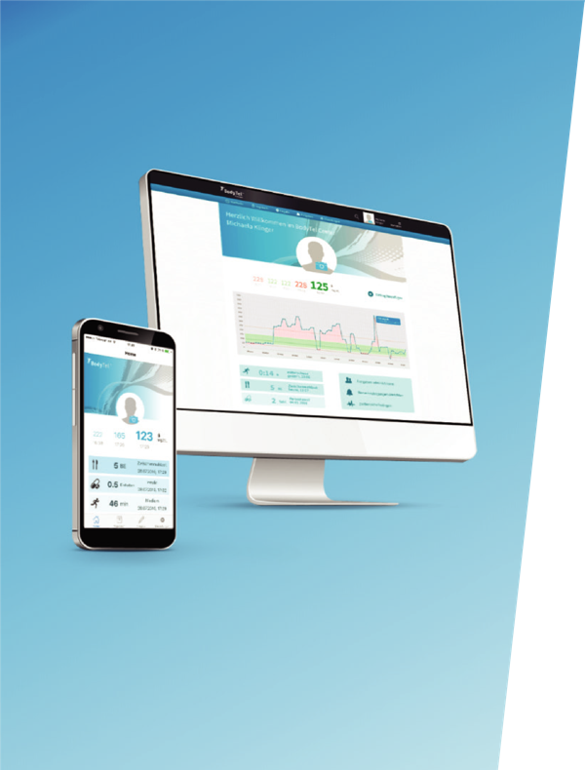
TEBP for primary population health management
®
TEBP® is digital health platform converging real-time sensor-based data using Bluetooth technology, smart device apps and manual entries into an integrated healthcare system.
Platform features
Closed loop patient & device management system
Identity management (stores patient data separately)
Dashboard (overview)
Diary of measured values
Manual entry and editing of measured values
Graphical evaluation of measured values
Statistics
Tele-monitoring of “friends & family“ in a non-professional environment
Healthcare Professional Views
DIGITALISATION OF VITALS FROM “SENSOR TO CLOUD” (COMPLIANT DIGITAL HEALTH RECORD)
Bluetooth sensor digitalisation
App development for iOS and Android
Back-end customisation in Cloud
Web development
Bluetooth simulator development
Analyse of vital parameters
SUPPORTING SAFE AND ACCURATE MEDICAL AND LIFESTYLE INTERVENTIONS

Slide 4
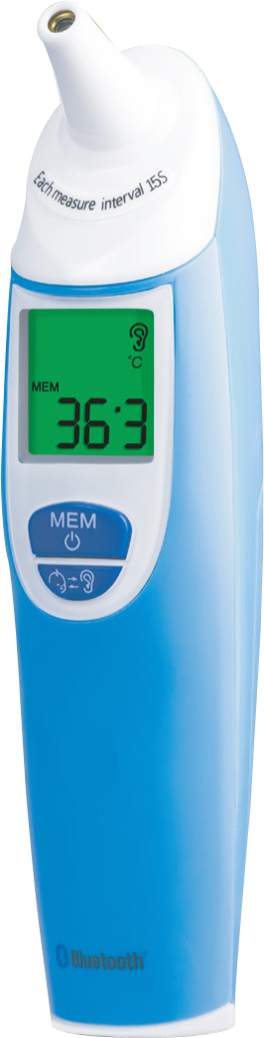














Supported devices
TET-351
Fever Check Bluetooth Digital
Thermometer Individual & Family
CoaguChek
Blood Clot Check
GlucoTel
Blood Glucose Meter
Omni 5 BT
Blood Glucose Meter
Gluco50 Evo
Blood Glucose Meter
Scale BF710
Bluetooth Scales (Weight Check)
BP BC85
Wrist Blood Pressure Monitor
BP BM85
Blood Pressure Monitor
BM95
CVD & Diabetes
Blood Pressure Monitor
ME90
Mobile ECG
M85 Bluetooth Scales (Weight Check)
PO60
Pulse Oximeter
Vaporizers
Cannabis Vaporizers CE Certified

Slide 5
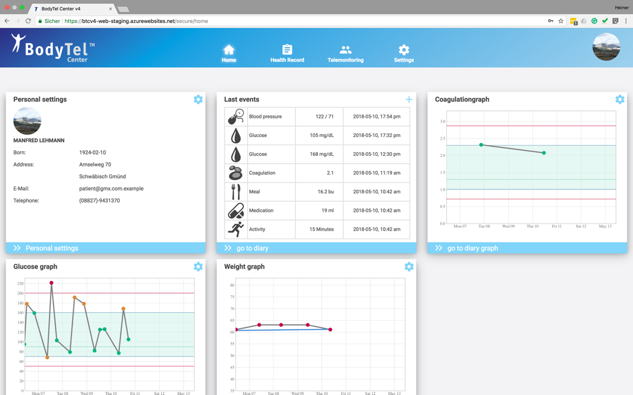
BODYTEL platform screenshots
®
Parameters can be customized based on automated device readings and manual inputs for multiple profiles.

Slide 6
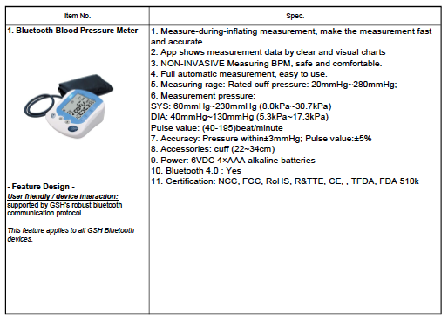
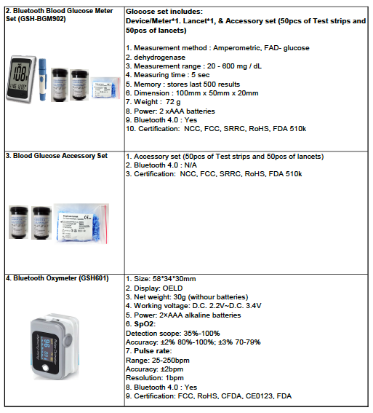

Slide 7
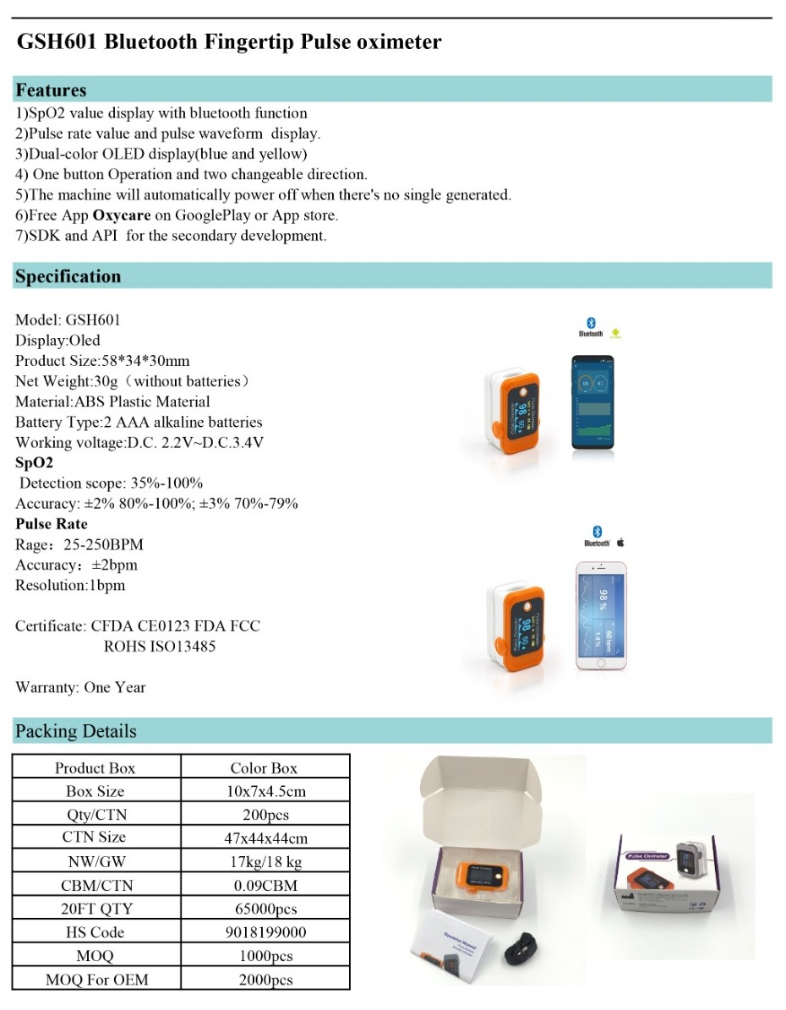

Slide 8
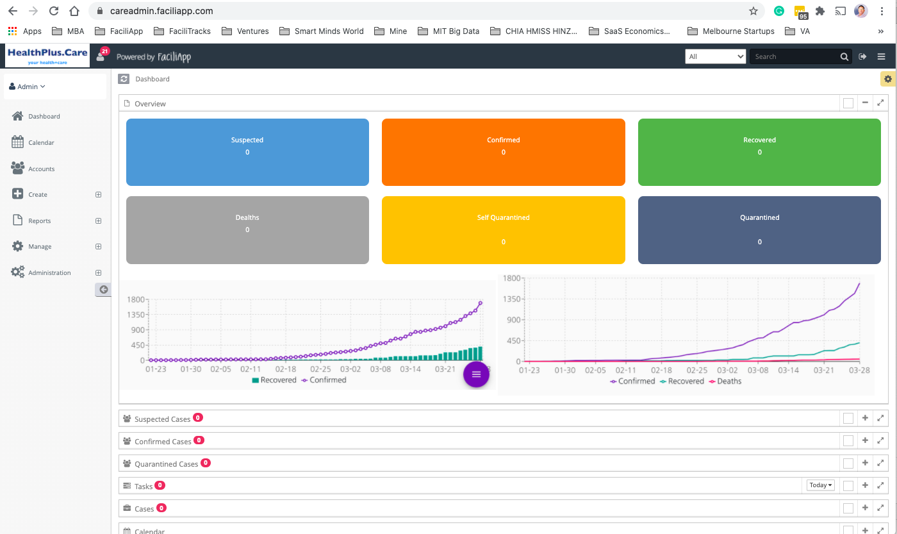
Health Dashboard using the software

